Slide 1
Module: 5 Hypothesis Testing I
Testing of hypothesis – Introduction-Types of errors, critical region, procedure of testing hypothesis-Large sample tests- Z test for Single Proportion, Difference of Proportion, mean and difference of means.

Slide 2
Population- This group of individuals under study is called population or universe.
Sample- A finite subset of statistical individuals in a population is called a sample and the number of individuals in sample is called the sample size.
Parameter-statistical measures of the population
Statistic- statistical measures of the sample

Slide 3
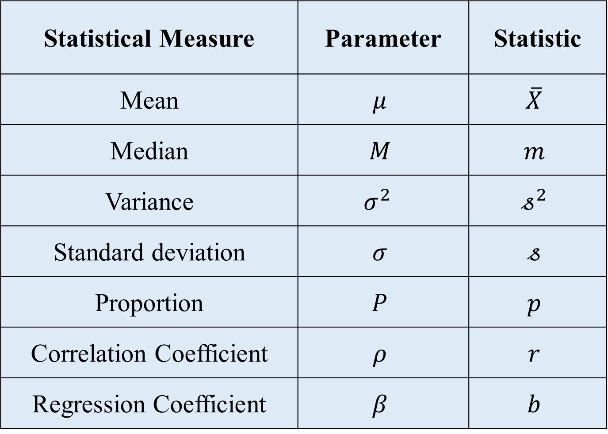
Statistical Measure | Parameter | Statistic
Mean | $$μ$$ | $$\overline{X}$$
Median | $$M$$ | $$m$$
Variance | $σ^{2}$ | $$𝓈^{2}$$
Standard deviation | $$σ$$ | $$𝓈$$
Proportion | $$P$$ | $$p$$
Correlation Coefficient | $$ρ$$ | $$r$$
Regression Coefficient | $$β$$ | $$b$$

Slide 4
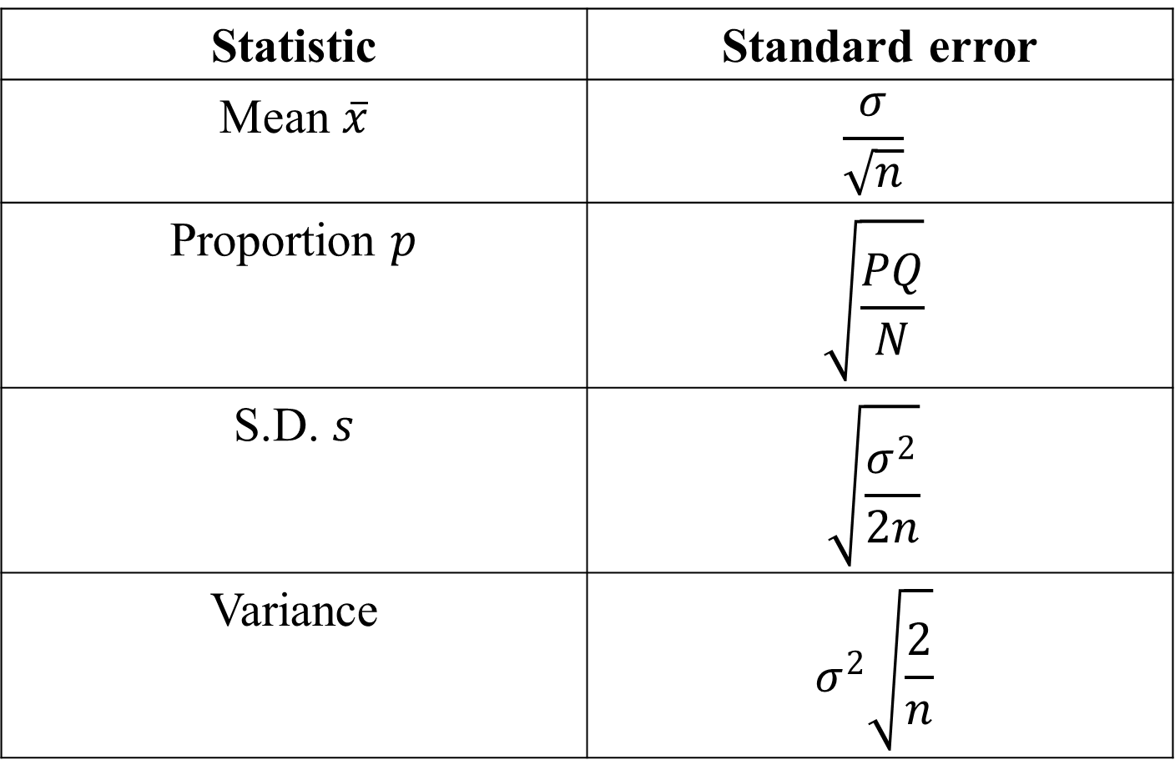
Standard Error – Standard deviation of the sampling distribution of a statistic.
Statistic | Standard error
Mean $\overline{x}$ | $$\frac{σ}{\sqrt{n}}$$
Proportion $p$ | $$\sqrt{\frac{PQ}{N}}$$
S.D. $s$ | $$\sqrt{\frac{σ^{2}}{2n}}$$
Variance | $$σ^{2}\sqrt{\frac{2}{n}}$$

Slide 5
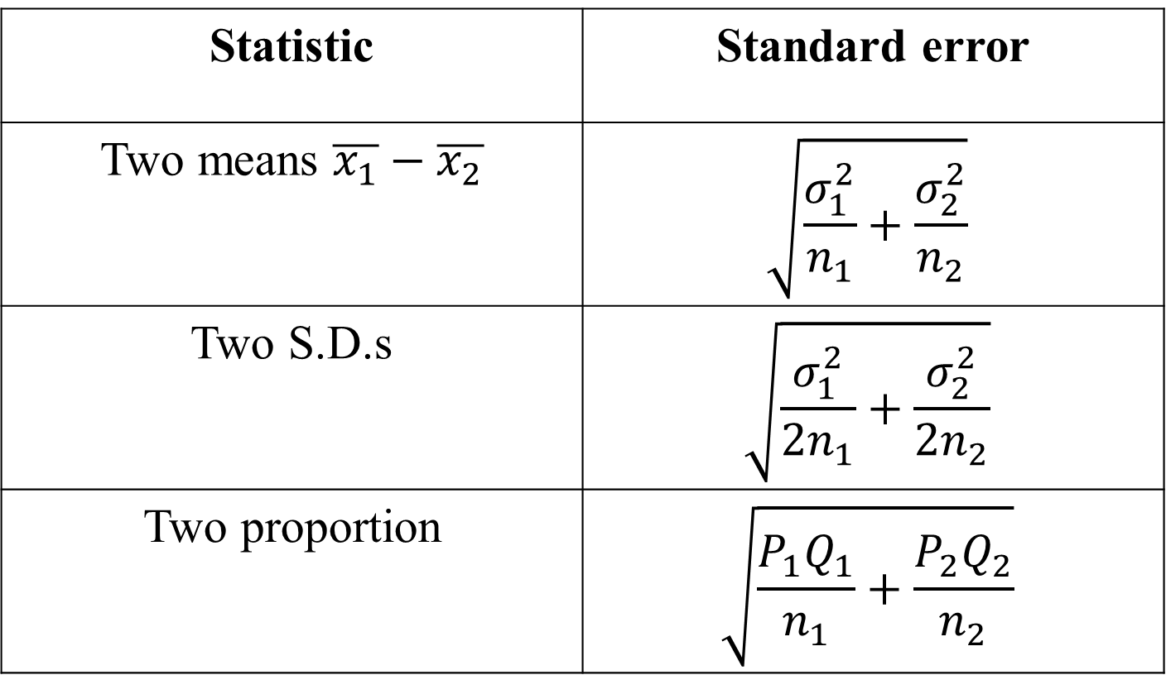
Statistic | Standard error
Two means $\overline{x_{1}}−\overline{x_{2}}$ | $$\sqrt{\frac{σ_{1}^{2}}{n_{1}}+\frac{σ_{2}^{2}}{n_{2}}}$$
Two S.D.s | $$\sqrt{\frac{σ_{1}^{2}}{{2n}_{1}}+\frac{σ_{2}^{2}}{{2n}_{2}}}$$
Two proportion | $$\sqrt{\frac{P_{1}Q_{1}}{n_{1}}+\frac{P_{2}Q_{2}}{n_{2}}}$$

Slide 6
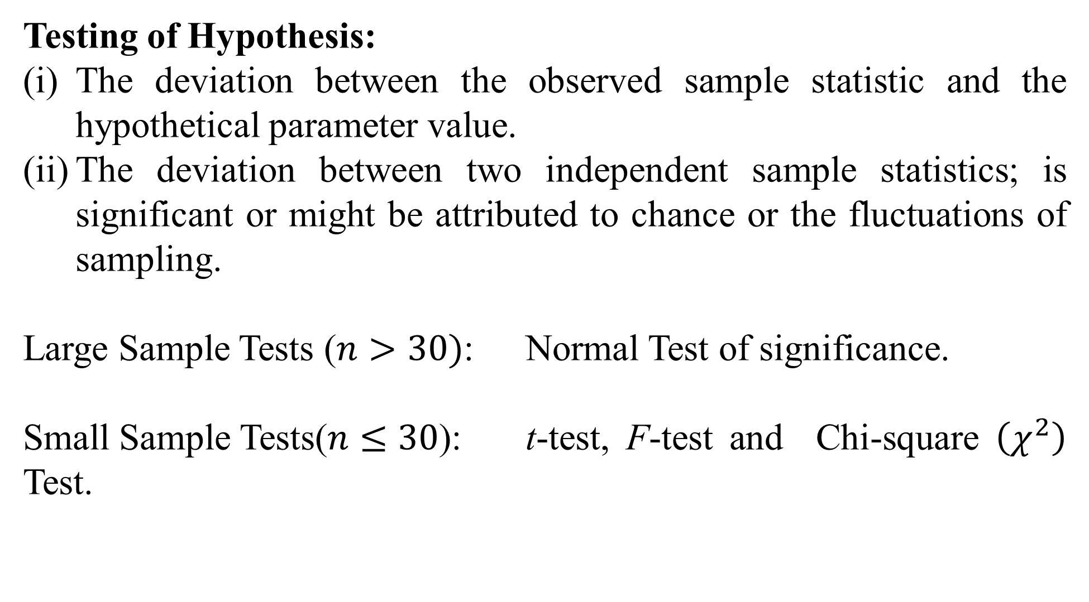
Testing of Hypothesis:
The deviation between the observed sample statistic and the hypothetical parameter value.
The deviation between two independent sample statistics; is significant or might be attributed to chance or the fluctuations of sampling.
Large Sample Tests ($n>30)$: Normal Test of significance.
Small Sample Tests($n≤30$): t-test, F-test and Chi-square $\left(χ^{2}\right)$ Test.

Slide 7
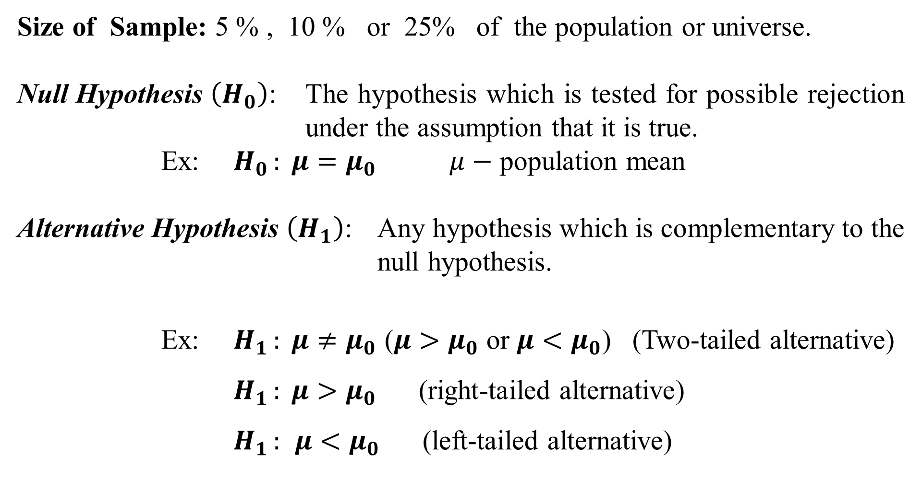
Size of Sample: 5 % , 10 % or 25% of the population or universe.
Null Hypothesis $\left(H_{0}\right)$: The hypothesis which is tested for possible rejection under the assumption that it is true.
Ex: $H_{0 }: μ=μ_{0}$ $μ−$ population mean
Alternative Hypothesis $\left(H_{1}\right)$: Any hypothesis which is complementary to the null hypothesis.
Ex: $H_{1 }: μ≠μ_{0}$ ($μ>μ_{0}$ or $μ<μ_{0}$) (Two-tailed alternative)
$H_{1 }: μ>μ_{0}$ (right-tailed alternative)
$H_{1 }:$ $μ<μ_{0}$ (left-tailed alternative)

Slide 8
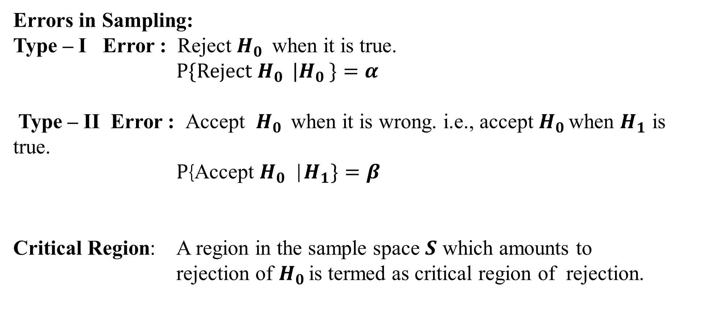
Errors in Sampling:
Type – I Error : Reject $H_{0 }$ when it is true.
$P\{\text{Reject} H_{0 } |H_{0 }\}=α$
Type – II Error : Accept $H_{0 }$ when it is wrong. i.e., accept $H_{0 }$when $H_{1}$ is true. $P${Accept $H_{0 }$|$H_{1}\}=β$
Critical Region: A region in the sample space $S$ which amounts to rejection of $H_{0 }$is termed as critical region of rejection.

Slide 9
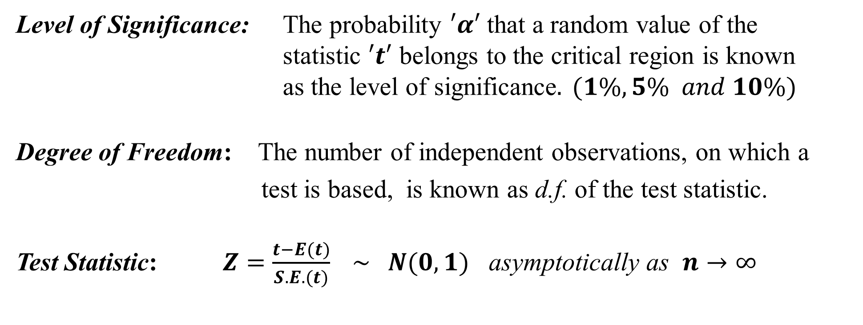
Level of Significance: The probability $′α′$ that a random value of the statistic $′t′$ belongs to the critical region is known as the level of significance$. (1\%, 5\% and 10\%)$
Degree of Freedom: The number of independent observations, on which a test is based, is known as d.f. of the test statistic.
Test Statistic: $Z=\frac{t−E(t)}{S.E.(t)} \sim N(0,1)$ asymptotically as $n→∞$

Slide 10
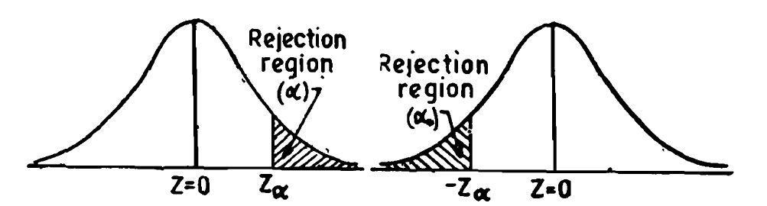
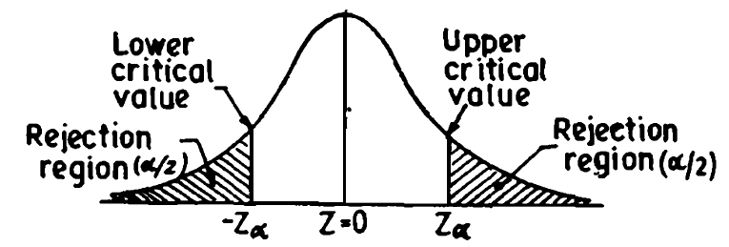
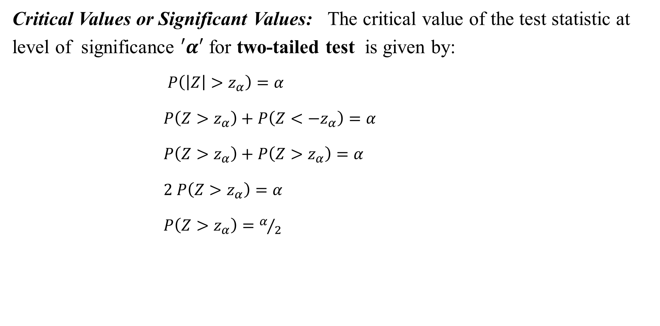
Critical Values or Significant Values: The critical value of the test statistic at level of significance $′α′$ for two-tailed test is given by:
$P\left(\left|Z\right|>z_{α}\right)=α$
$P\left(Z>z_{α}\right)+P\left(Z<{−z}_{α}\right)=α$
$P\left(Z>z_{α}\right)+P\left(Z>z_{α}\right)=α$
$2 P\left(Z>z_{α}\right)=α$
$P\left(Z>z_{α}\right)=α/2$

Slide 11

In case of one-tailed test, the critical value $z_{α}$ is determined as:
For right tailed test : $P\left(Z>z_{α}\right)=α$
For left tailed test : $P\left(Z<{−z}_{α}\right)=α$

Slide 12
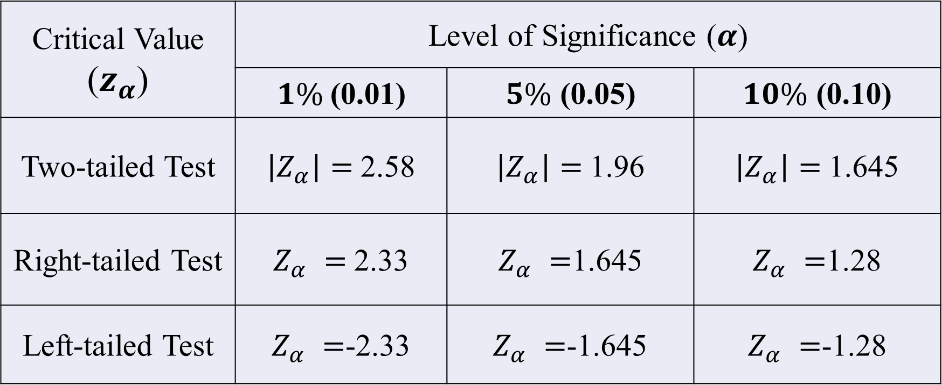

The critical values of $Z$ at commonly used level of significance
Critical Value ($z_{α}$) | Level of Significance ($α$)
 | $1\%$(0.01) | $5\%$ (0.05) | $10\%$ (0.10)
Two-tailed Test | $\left|Z_{α}\right|=$2.58 | $\left|Z_{α}\right|=$1.96 | $\left|Z_{α}\right|=$1.645
Right-tailed Test | $Z_{α} =$2.33 | $Z_{α} =$1.645 | $Z_{α} =$1.28
Left-tailed Test | $Z_{α} =$-2.33 | $Z_{α} =$-1.645 | $Z_{α} =$-1.28

Slide 13
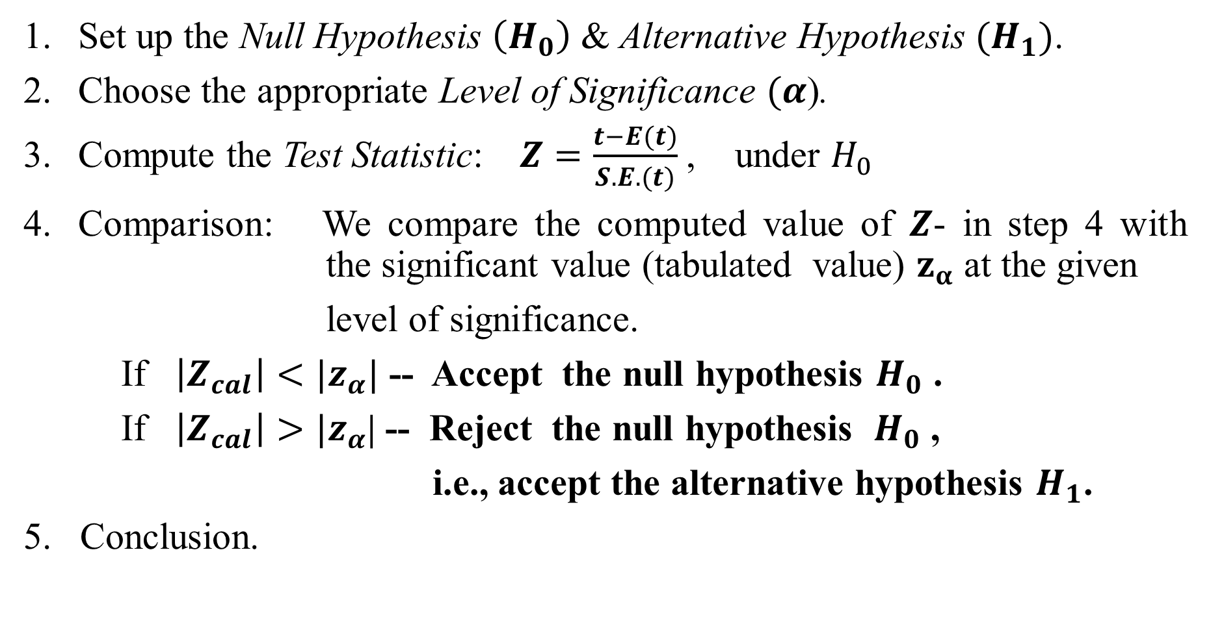
Procedure for Testing of Hypothesis
Set up the Null Hypothesis $\left(H_{0}\right)$ & Alternative Hypothesis $(H_{1})$.
Choose the appropriate Level of Significance $(α$).
Compute the Test Statistic: $Z=\frac{t−E(t)}{S.E.(t)}$, under $H_{0}$
Comparison: We compare the computed value of $Z$- in step 4 with the significant value (tabulated value) $z_{α}$ at the given
level of significance.
If $\left|Z_{cal}\right|<{|z}_{α}|$ -- Accept the null hypothesis $H_{0}$ .
If $\left|Z_{cal}\right|>{|z}_{α}$| -- Reject the null hypothesis ${ H}_{0}$ ,
i.e., accept the alternative hypothesis $H_{1}$.
5. Conclusion.

Slide 14
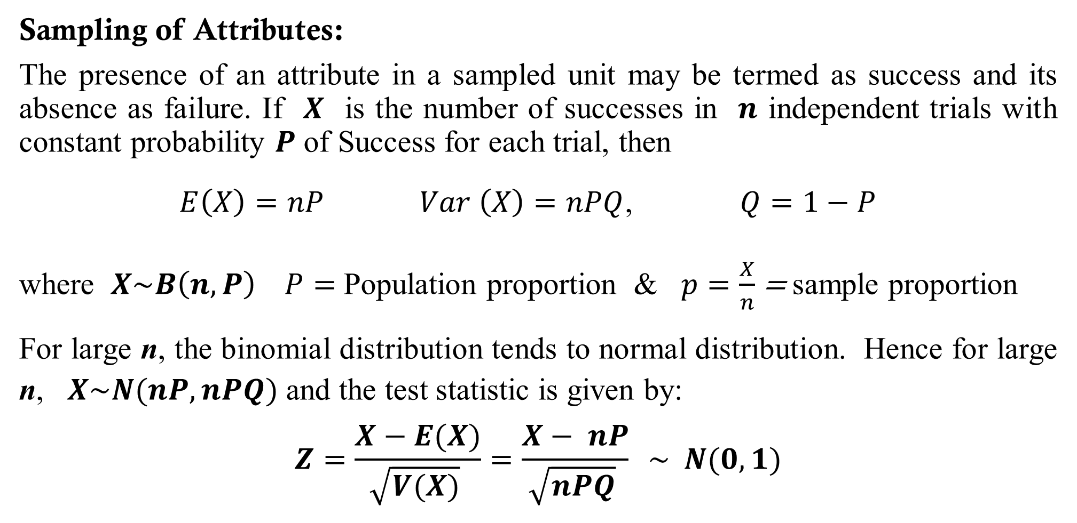
Sampling of Attributes:
The presence of an attribute in a sampled unit may be termed as success and its absence as failure. If $X$ is the number of successes in $n$ independent trials with constant probability $P$ of Success for each trial, then
$E\left(X\right)=nP$ $Var \left(X\right)=nPQ$, $Q=1−P$
where $X\sim B\left(n, P\right)$ $P=$ Population proportion & $p=\frac{X}{n}$ = sample proportion
For large n, the binomial distribution tends to normal distribution. Hence for large n, $X\sim N(nP, nPQ)$ and the test statistic is given by:
$$Z=\frac{X−E(X)}{\sqrt{V(X)} }=\frac{X− nP}{\sqrt{nPQ} } \sim N(0,1)$$

Slide 15
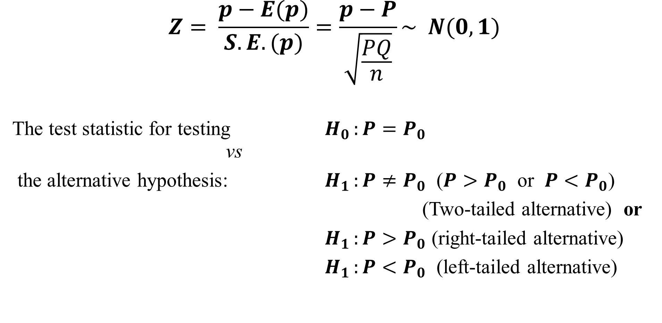
Test for Single Proportion:
$$Z= \frac{p−E(p)}{S.E.(p)}=\frac{p−P}{\sqrt{\frac{PQ}{n}}}\sim N(0,1)$$
The test statistic for testing $H_{0 }:P=P_{0}$ vs
the alternative hypothesis: $H_{1 }:P≠P_{0}$ ($P>P_{0}$ or $P<P_{0}$)
(Two-tailed alternative) or
$H_{1 }:P>P_{0}$ (right-tailed alternative)
$H_{1 }:P<P_{0}$ (left-tailed alternative)

Slide 16
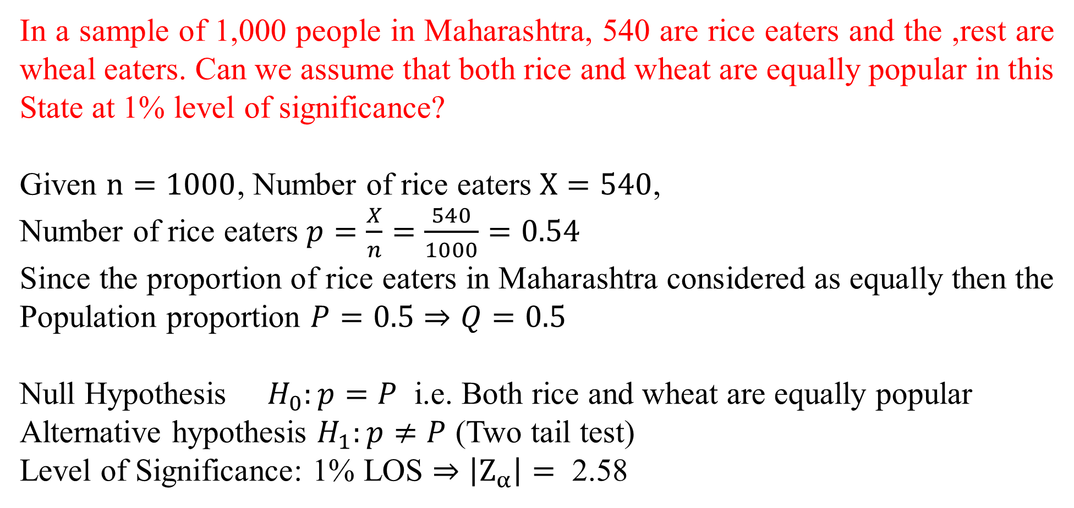
In a sample of 1,000 people in Maharashtra, 540 are rice eaters and the ,rest are wheal eaters. Can we assume that both rice and wheat are equally popular in this State at 1% level of significance?
Given $n=1000$, Number of rice eaters $X=540$,
Number of rice eaters $p=\frac{X}{n}=\frac{540}{1000}=0.54$
Since the proportion of rice eaters in Maharashtra considered as equally then the Population proportion $P=0.5⇒Q=0.5$
Null Hypothesis $H_{0}:p=P$ i.e. Both rice and wheat are equally popular
Alternative hypothesis $H_{1}:p≠P$ (Two tail test)
Level of Significance: 1% LOS $⇒\left|Z_{α}\right|= \text{2.58}$

Slide 17
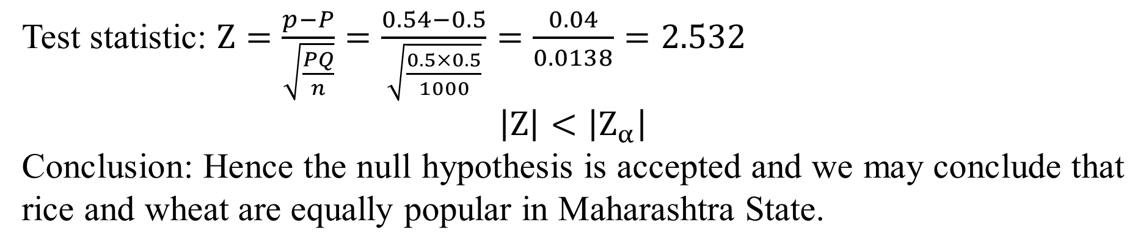
Test statistic: $Z=\frac{p−P}{\sqrt{\frac{PQ}{n}}}=\frac{0.54−0.5}{\sqrt{\frac{0.5×0.5}{1000}}}=\frac{0.04}{0.0138}=2.532$
$$\left|Z\right|<\left|Z_{α}\right|$$
Conclusion: Hence the null hypothesis is accepted and we may conclude that rice and wheat are equally popular in Maharashtra State.

Slide 18
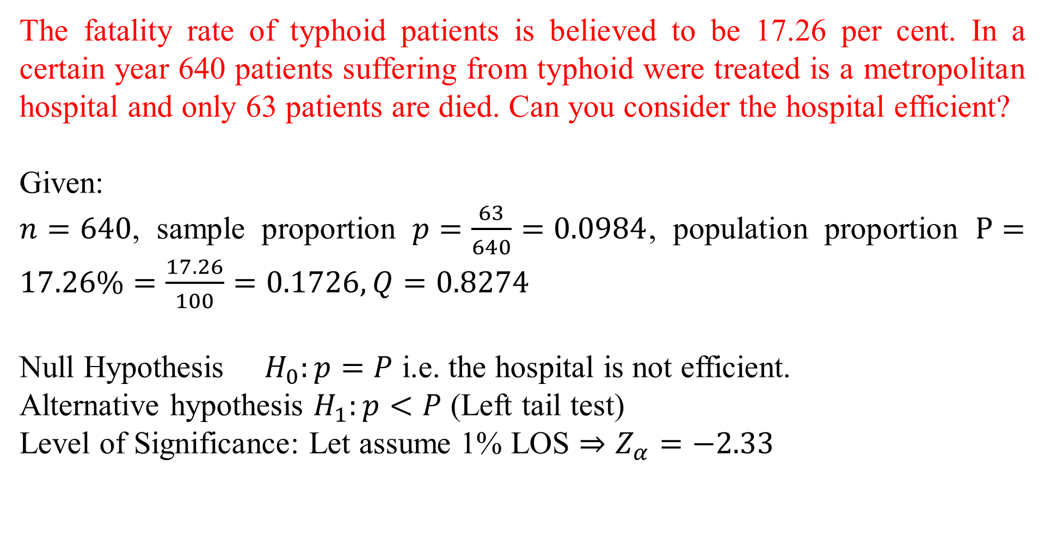
The fatality rate of typhoid patients is believed to be 17.26 per cent. In a certain year 640 patients suffering from typhoid were treated is a metropolitan hospital and only 63 patients are died. Can you consider the hospital efficient?
Given:
$n=640$, sample proportion $p=\frac{63}{640}=0.0984$, population proportion $P=17.26\%=\frac{17.26}{100}=0.1726, Q=0.8274$
Null Hypothesis $H_{0}:p=P$ i.e. the hospital is not efficient.
Alternative hypothesis $H_{1}:p<P$ (Left tail test)
Level of Significance: Let assume 1% LOS $⇒Z_{α}=−2.33$

Slide 19
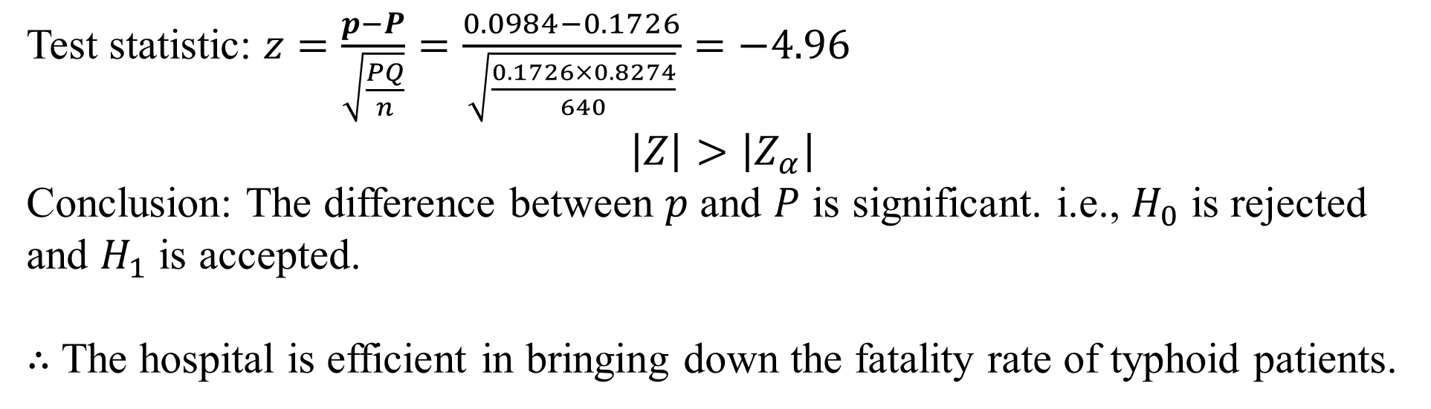
Test statistic: $z=\frac{p−P}{\sqrt{\frac{PQ}{n}}}=\frac{0.0984−0.1726}{\sqrt{\frac{0.1726×0.8274}{640}}}=−4.96$
$$\left|Z\right|>\left|Z_{α}\right|$$
Conclusion: The difference between $p$ and $P$ is significant. i.e., $H_{0}$ is rejected and $H_{1}$ is accepted.
$∴$ The hospital is efficient in bringing down the fatality rate of typhoid patients.

Slide 20
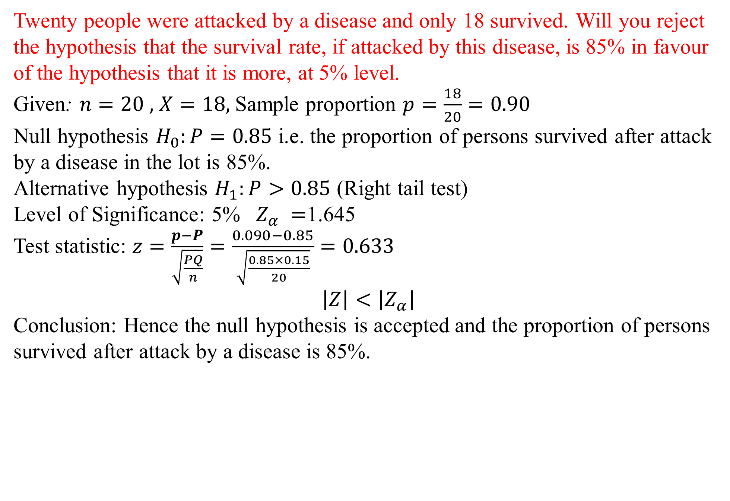
Twenty people were attacked by a disease and only 18 survived. Will you reject the hypothesis that the survival rate, if attacked by this disease, is 85% in favour of the hypothesis that it is more, at 5% level.
Given: $n=20 ,$ $X=18,$Sample proportion $p=\frac{18}{20}=0.90$
Null hypothesis $H_{0}:P=0.85$ i.e. the proportion of persons survived after attack by a disease in the lot is 85%.
Alternative hypothesis $H_{1}:P>0.85$ (Right tail test)
Level of Significance: 5% $Z_{α} =$1.645
Test statistic: $z=\frac{p−P}{\sqrt{\frac{PQ}{n}}}=\frac{0.090−0.85}{\sqrt{\frac{0.85×0.15}{20}}}=0.633$
$$\left|Z\right|<\left|Z_{α}\right|$$
Conclusion: Hence the null hypothesis is accepted and the proportion of persons survived after attack by a disease is 85%.

Slide 21
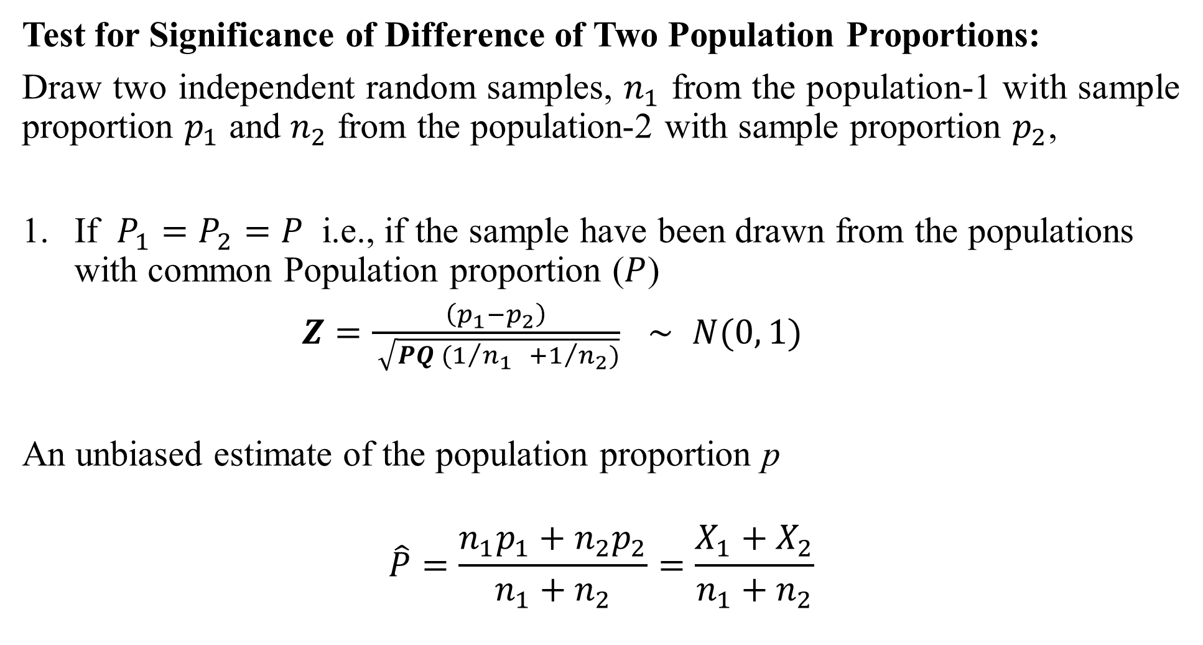
Test for Significance of Difference of Two Population Proportions:
Draw two independent random samples, $n_{1}$ from the population-1 with sample proportion $p_{1}$ and $n_{2}$ from the population-2 with sample proportion $p_{2}$,
If $P_{1}=P_{2}=P$ i.e., if the sample have been drawn from the populations with common Population proportion ($P$)
$Z=\frac{\left(p_{1}−p_{2}\right)}{ \sqrt{{PQ (1}/{n_{1 } }+1/{n_{2})}}}$ $\sim$ $N(0, 1)$
An unbiased estimate of the population proportion p
$$\hat{P}=\frac{n_{1}p_{1}+n_{2}p_{2}}{n_{1}+n_{2}}=\frac{X_{1}+X_{2}}{n_{1}+n_{2}}$$

Slide 22
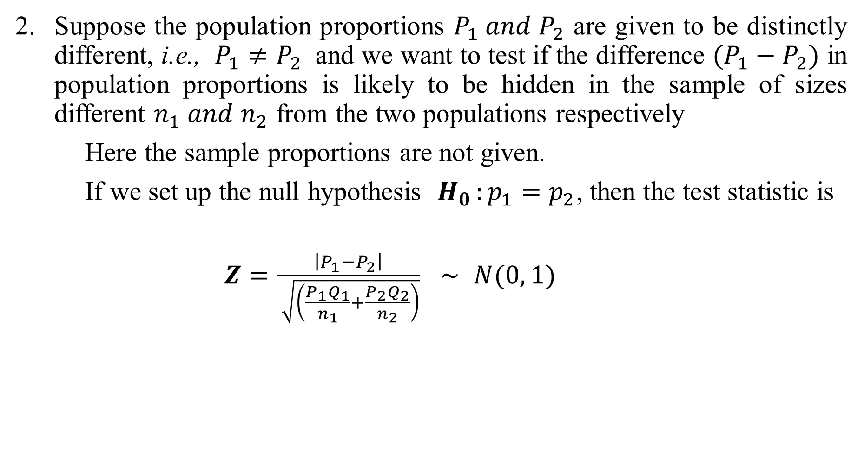
Suppose the population proportions $P_{1} and P_{2}$ are given to be distinctly different, i.e., $P_{1}≠P_{2}$ and we want to test if the difference $(P_{1}−P_{2})$ in population proportions is likely to be hidden in the sample of sizes different $n_{1} and n_{2}$ from the two populations respectively
Here the sample proportions are not given.
If we set up the null hypothesis $H_{0 }:p_{1}=p_{2}$, then the test statistic is
$Z=\frac{\left|P_{1}−P_{2}\right|}{ \sqrt{\left(\frac{P_{1}Q_{1}}{n_{1}}+\frac{P_{2}Q_{2}}{n_{2}}\right)}}$ $\sim$ $N(0, 1)$

Slide 23
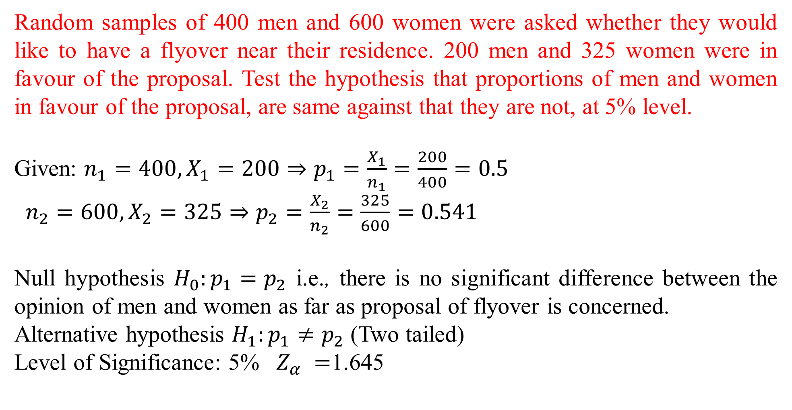
Random samples of 400 men and 600 women were asked whether they would like to have a flyover near their residence. 200 men and 325 women were in favour of the proposal. Test the hypothesis that proportions of men and women in favour of the proposal, are same against that they are not, at 5% level.
Given: $n_{1}=400, X_{1}=200⇒p_{1}=\frac{X_{1}}{n_{1}}=\frac{200}{400}=0.5$
${n_{2}=600, X}_{2}=325⇒p_{2}=\frac{X_{2}}{n_{2}}=\frac{325}{600}=0.541$
Null hypothesis $H_{0}:p_{1}=p_{2}$ i.e., there is no significant difference between the opinion of men and women as far as proposal of flyover is concerned.
Alternative hypothesis $H_{1}:p_{1}≠p_{2}$ (Two tailed)
Level of Significance: 5% $Z_{α} =$1.645

Slide 24
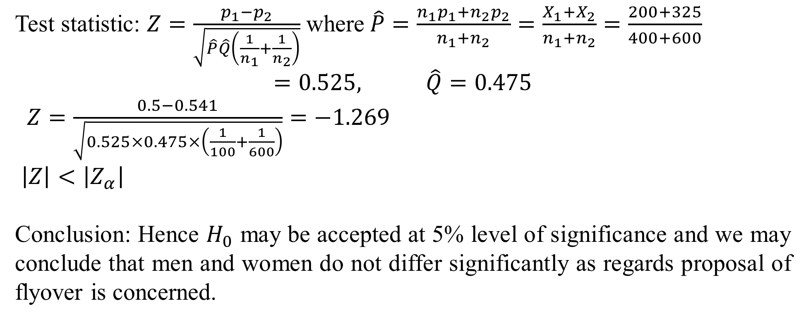
Test statistic: $Z=\frac{p_{1}−p_{2}}{\sqrt{\hat{P}\hat{Q}\left(\frac{1}{n_{1}}+\frac{1}{n_{2}}\right)}}$ where$\hat{P}=\frac{n_{1}p_{1}+n_{2}p_{2}}{n_{1}+n_{2}}=\frac{X_{1}+X_{2}}{n_{1}+n_{2}}=\frac{200+325}{400+600}$
$$=0.525, \hat{Q}=0.475$$
$Z=\frac{0.5−0.541}{\sqrt{0.525×0.475×\left(\frac{1}{100}+\frac{1}{600}\right)}}=−1.269$
$\left|Z\right|<\left|Z_{α}\right|$
Conclusion: Hence $H_{0}$ may be accepted at 5% level of significance and we may conclude that men and women do not differ significantly as regards proposal of flyover is concerned.

Slide 25
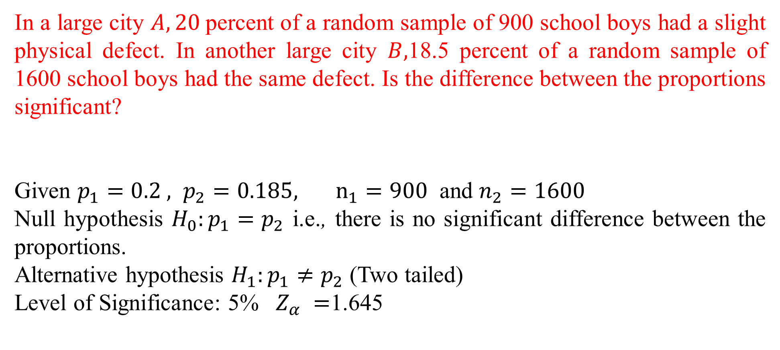
In a large city $A, 20$percent of a random sample of 900 school boys had a slight physical defect. In another large city $B,$18.5 percent of a random sample of 1600 school boys had the same defect. Is the difference between the proportions significant?
Given $p_{1}=0.2 , p_{2}=0.185, n_{1}=900$ and $n_{2}=1600$
Null hypothesis $H_{0}:p_{1}=p_{2}$ i.e., there is no significant difference between the proportions.
Alternative hypothesis $H_{1}:p_{1}≠p_{2}$ (Two tailed)
Level of Significance: 5% $Z_{α} =$1.645

Slide 26
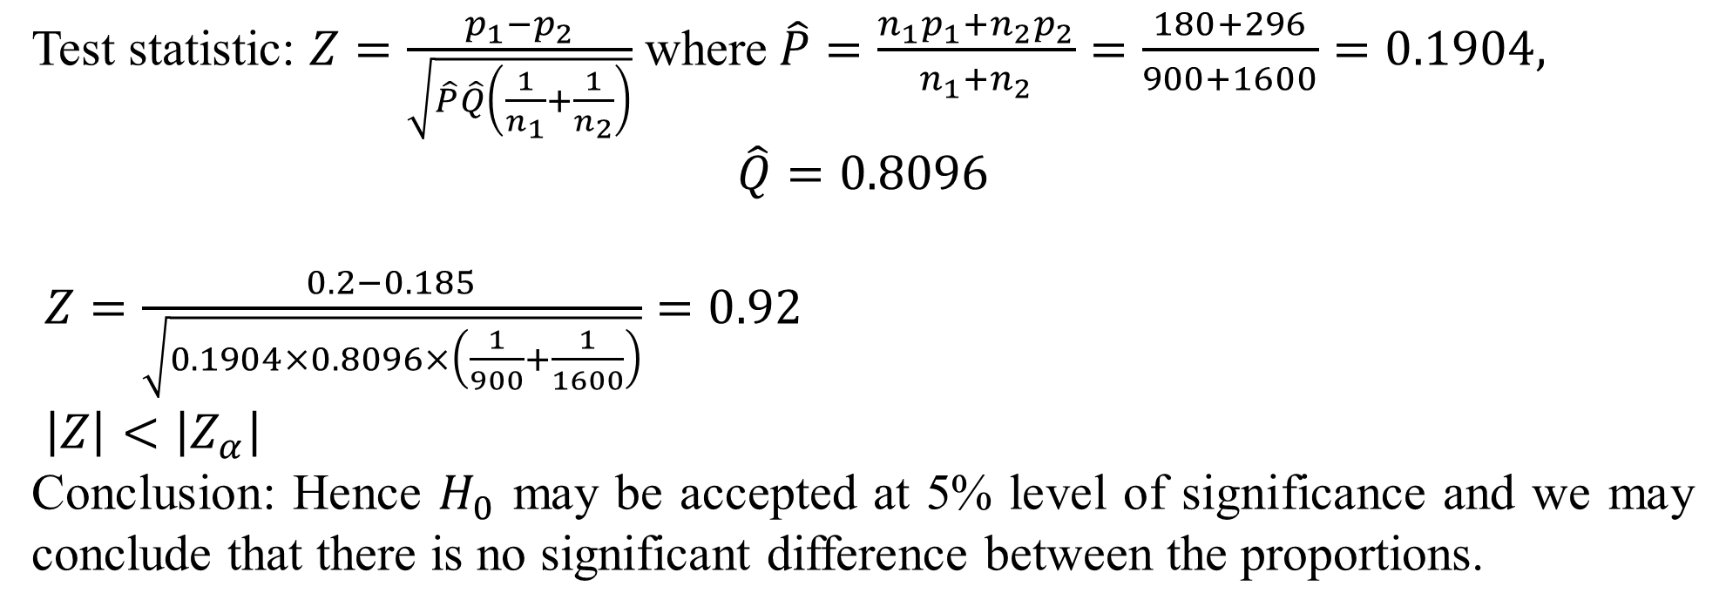
Test statistic: $Z=\frac{p_{1}−p_{2}}{\sqrt{\hat{P}\hat{Q}\left(\frac{1}{n_{1}}+\frac{1}{n_{2}}\right)}}$ where$\hat{P}=\frac{n_{1}p_{1}+n_{2}p_{2}}{n_{1}+n_{2}}=\frac{180+296}{900+1600}=0.1904,$
$$\hat{Q}=0.8096$$
$Z=\frac{0.2−0.185}{\sqrt{0.1904×0.8096×\left(\frac{1}{900}+\frac{1}{1600}\right)}}=0.92$
$\left|Z\right|<\left|Z_{α}\right|$
Conclusion: Hence $H_{0}$ may be accepted at 5% level of significance and we may conclude that there is no significant difference between the proportions.

Slide 27
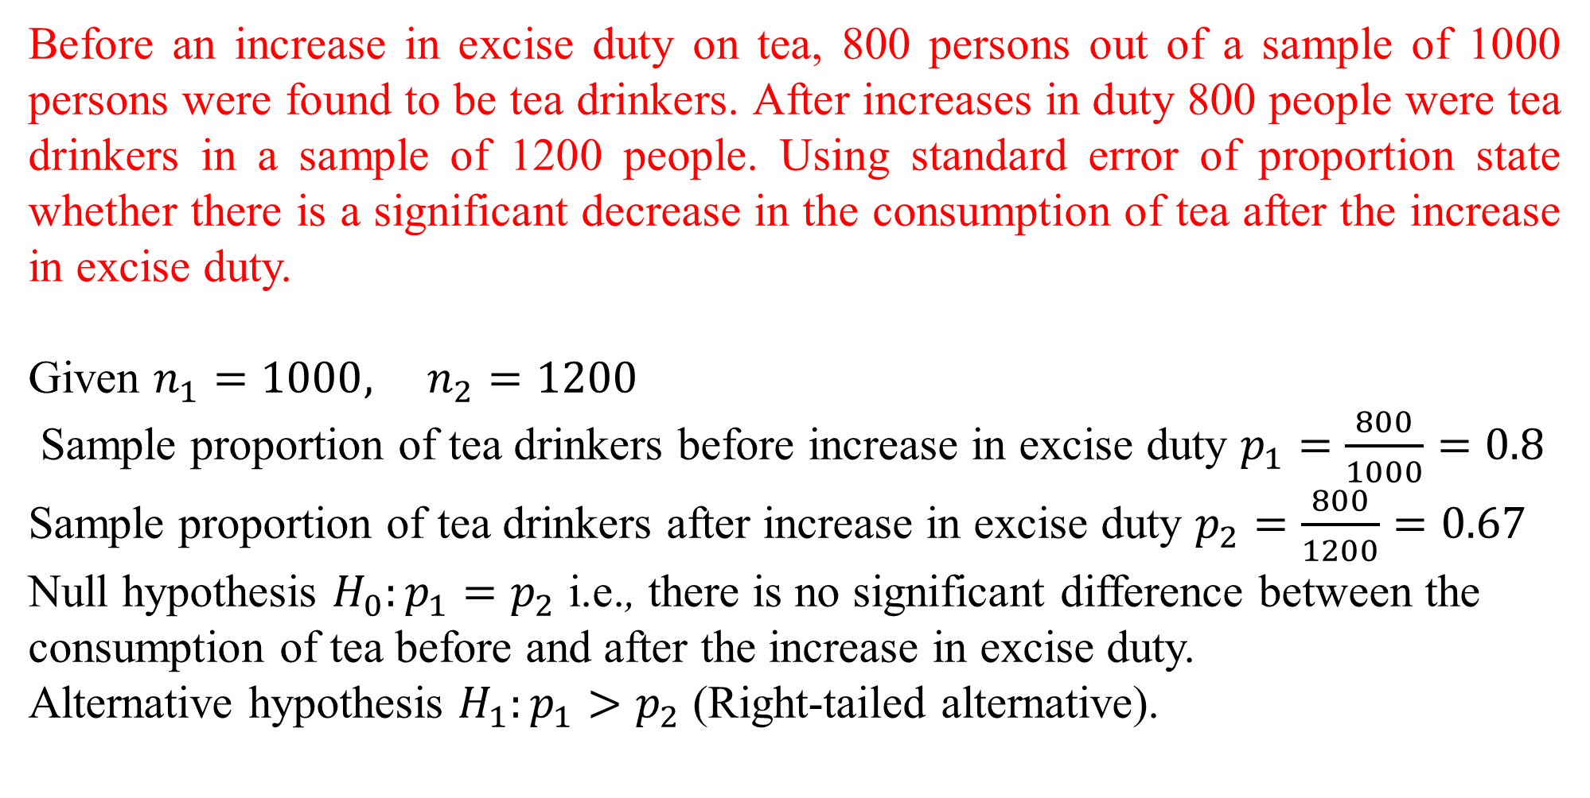
Before an increase in excise duty on tea, 800 persons out of a sample of 1000 persons were found to be tea drinkers. After increases in duty 800 people were tea drinkers in a sample of 1200 people. Using standard error of proportion state whether there is a significant decrease in the consumption of tea after the increase in excise duty.
Given $n_{1}=1000, n_{2}=1200$
Sample proportion of tea drinkers before increase in excise duty $p_{1}=\frac{800}{1000}=0.8$
Sample proportion of tea drinkers after increase in excise duty $p_{2}=\frac{800}{1200}=0.67$
Null hypothesis $H_{0}:p_{1}=p_{2}$ i.e., there is no significant difference between the
consumption of tea before and after the increase in excise duty.
Alternative hypothesis $H_{1}:p_{1}>p_{2}$ (Right-tailed alternative).

Slide 28
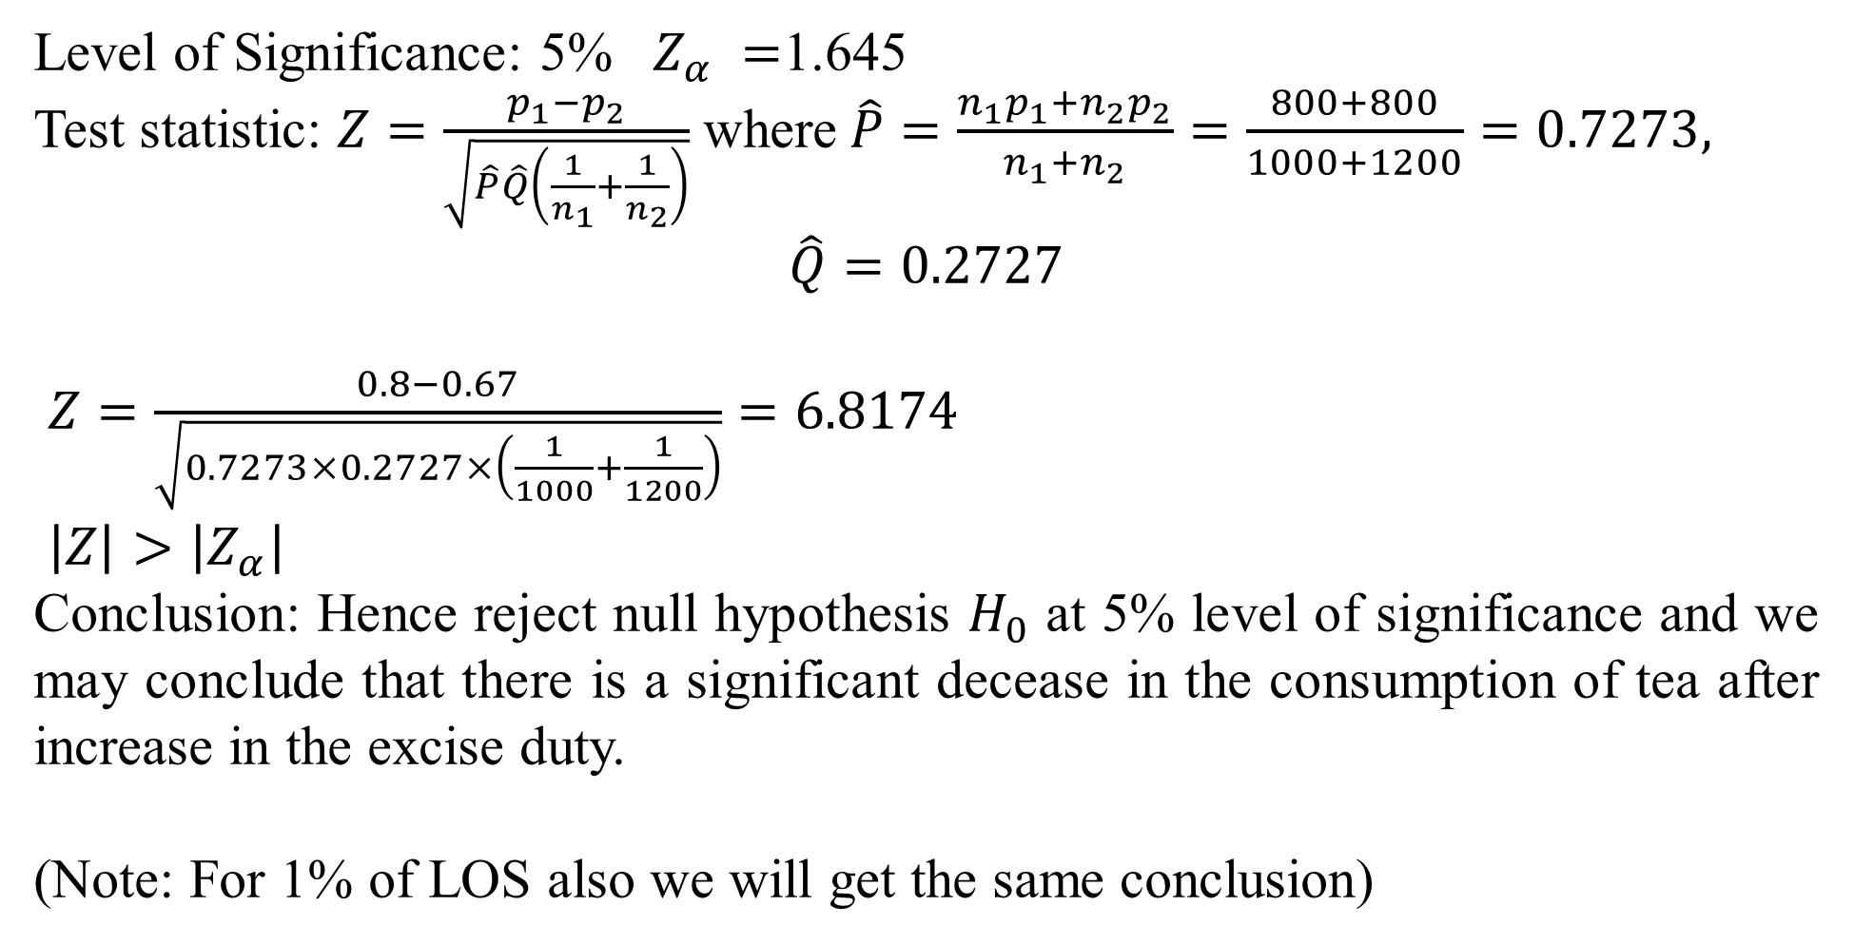
Level of Significance: 5% $Z_{α} =$1.645
Test statistic: $Z=\frac{p_{1}−p_{2}}{\sqrt{\hat{P}\hat{Q}\left(\frac{1}{n_{1}}+\frac{1}{n_{2}}\right)}}$ where$\hat{P}=\frac{n_{1}p_{1}+n_{2}p_{2}}{n_{1}+n_{2}}=\frac{800+800}{1000+1200}=0.7273,$
$$\hat{Q}=0.2727$$
$Z=\frac{0.8−0.67}{\sqrt{0.7273×0.2727×\left(\frac{1}{1000}+\frac{1}{1200}\right)}}=6.8174$
$\left|Z\right|>\left|Z_{α}\right|$
Conclusion: Hence reject null hypothesis $H_{0}$ at 5% level of significance and we may conclude that there is a significant decease in the consumption of tea after increase in the excise duty.
(Note: For 1% of LOS also we will get the same conclusion)

Slide 29
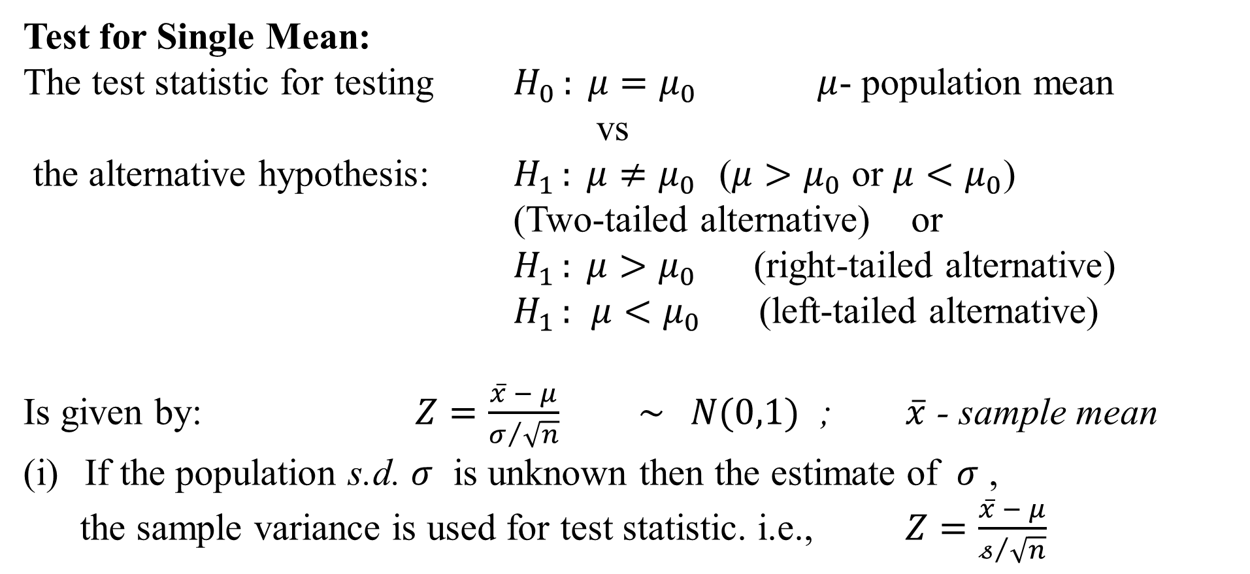
Test for Single Mean:
The test statistic for testing $H_{0 }: μ=μ_{0}$ $μ$- population mean
vs
the alternative hypothesis: $H_{1 }: μ≠μ_{0}$ ($μ>μ_{0}$ or $μ<μ_{0}$)
(Two-tailed alternative) or
$H_{1 }: μ>μ_{0}$ (right-tailed alternative)
$H_{1 }:$ $μ<μ_{0}$ (left-tailed alternative)
Is given by: $Z=\frac{\overline{x} − μ}{σ/{\sqrt{n}}}$ $\sim N(0,1)$ ; $\overline{x}$ - sample mean
If the population s.d. $σ$ is unknown then the estimate of $σ$ ,
the sample variance is used for test statistic. i.e., $Z=\frac{\overline{x} − μ}{𝓈/{\sqrt{n}}}$

Slide 30
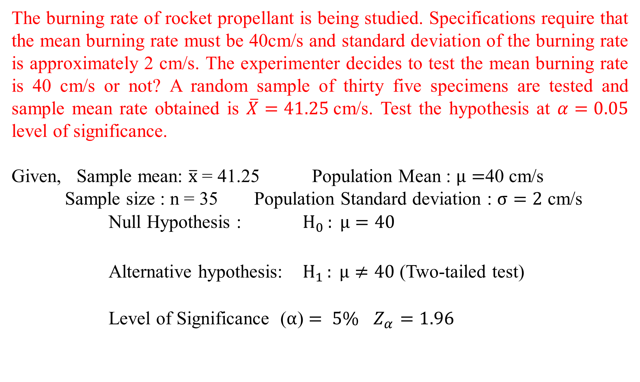
The burning rate of rocket propellant is being studied. Specifications require that the mean burning rate must be 40cm/s and standard deviation of the burning rate is approximately 2 cm/s. The experimenter decides to test the mean burning rate is 40 cm/s or not? A random sample of thirty five specimens are tested and sample mean rate obtained is $\overline{X}=41.25$cm/s. Test the hypothesis at $α=0.05$ level of significance.
Given, Sample mean: $\overline{x}$ = 41.25 Population Mean : $μ=$40 cm/s
Sample size : n = 35 Population Standard deviation : $σ=2$ cm/s
Null Hypothesis : $H_{0 }: μ=40$
Alternative hypothesis: $H_{1 }: μ≠40$ (Two-tailed test)
Level of Significance ($α$) $= 5\%$ $Z_{α}=1.96$

Slide 31
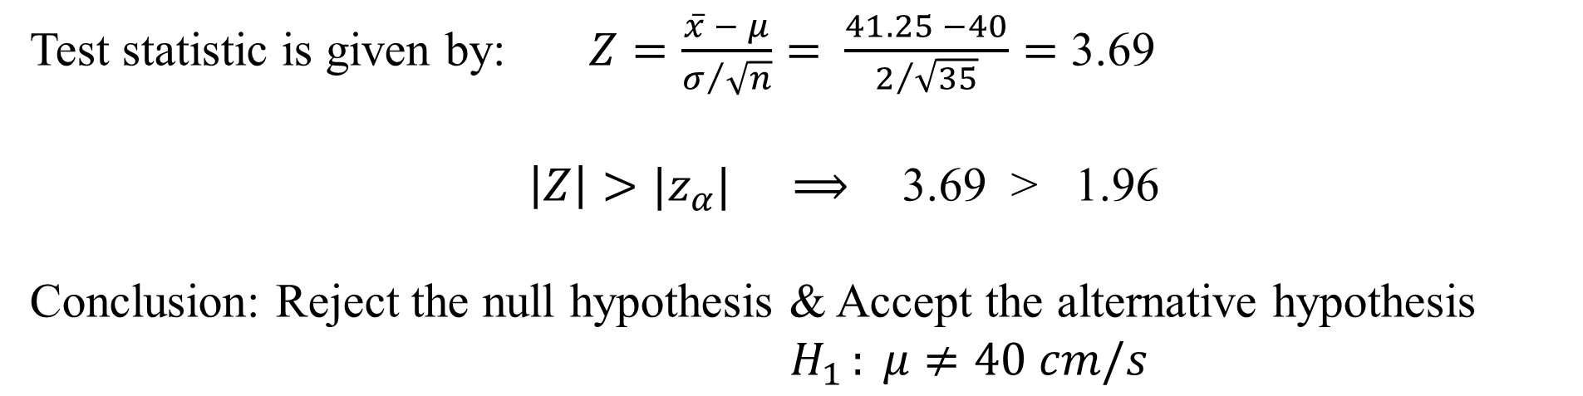
Test statistic is given by: $Z=\frac{\overline{x} − μ}{σ/{\sqrt{n}}}=$ $\frac{41.25 −40}{2/{\sqrt{35}}}=$ 3.69
$\left|Z\right|>{|z}_{α}|$ $⟹$ 3.69 > 1.96
Conclusion: Reject the null hypothesis & Accept the alternative hypothesis
$H_{1 }: μ≠40 cm/s$

Slide 32
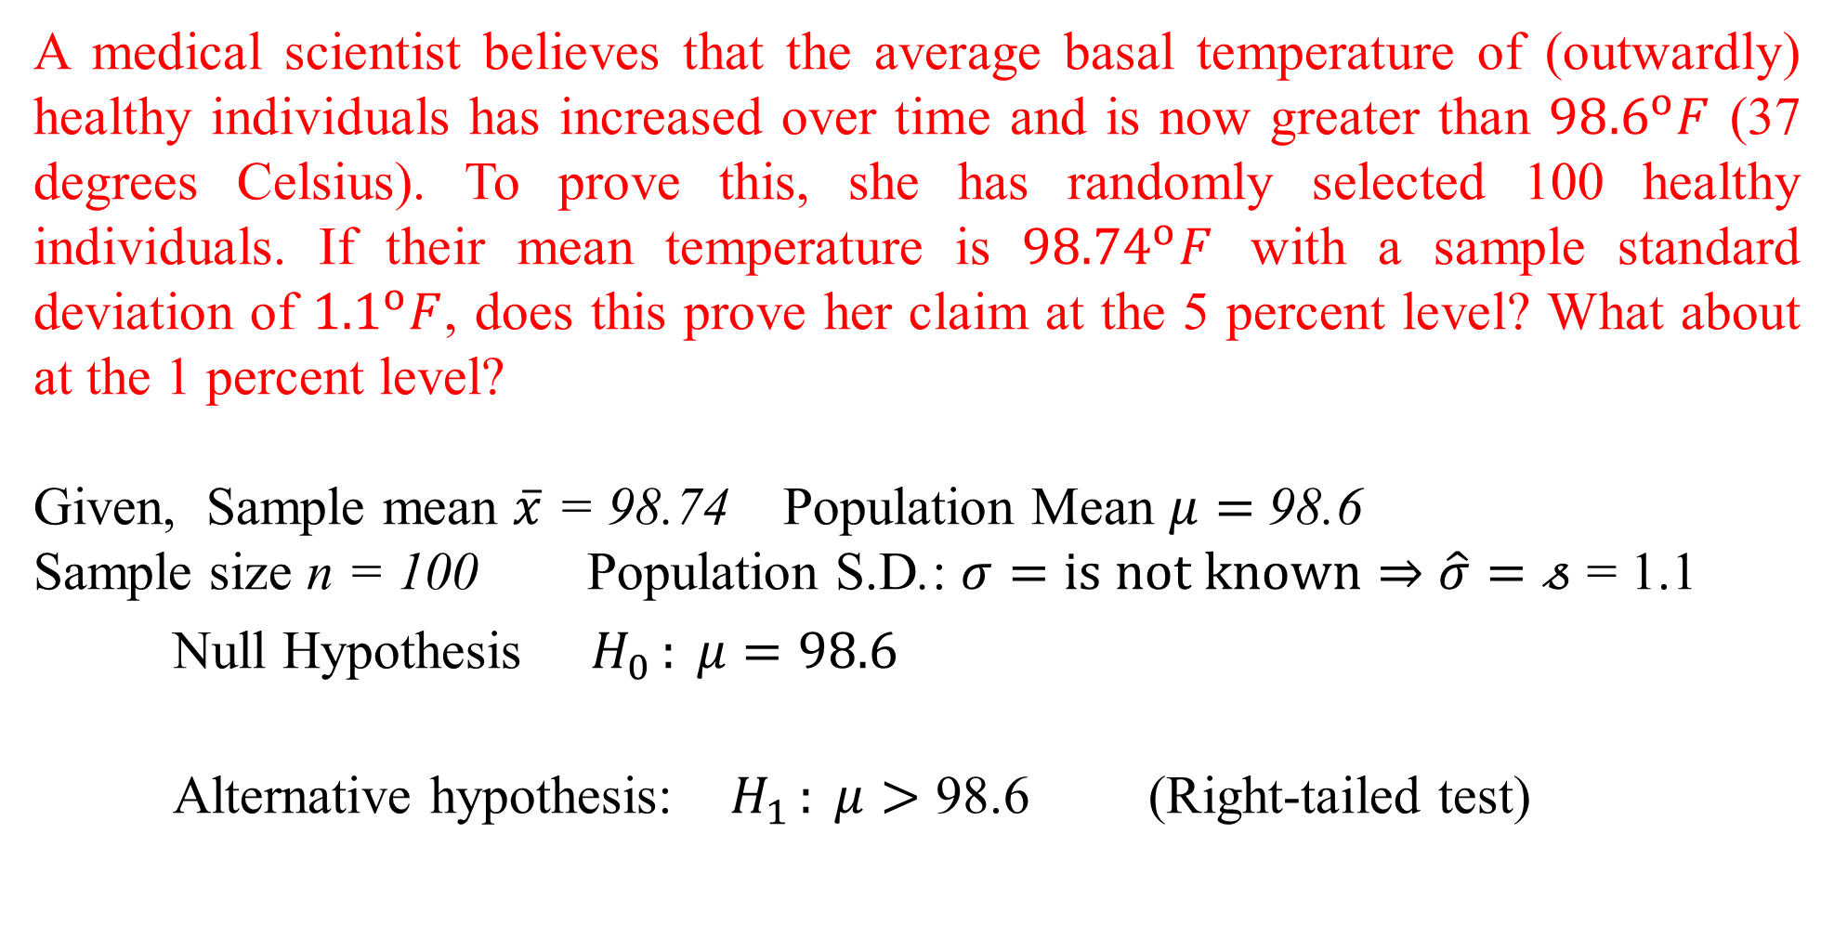
A medical scientist believes that the average basal temperature of (outwardly) healthy individuals has increased over time and is now greater than ${98.6}^{o}F$ (37 degrees Celsius). To prove this, she has randomly selected 100 healthy individuals. If their mean temperature is ${98.74}^{o}F$ with a sample standard deviation of ${1.1}^{o}F$, does this prove her claim at the 5 percent level? What about at the 1 percent level?
Given, Sample mean $\overline{x}$ = 98.74 Population Mean $μ=$ 98.6
Sample size n = 100 Population S.D.: $σ=is not known⇒$ $\hat{σ}=𝓈$ = 1.1
Null Hypothesis $H_{0 }: μ=98.6$
Alternative hypothesis: $H_{1 }: μ>$ 98.6 (Right-tailed test)

Slide 33
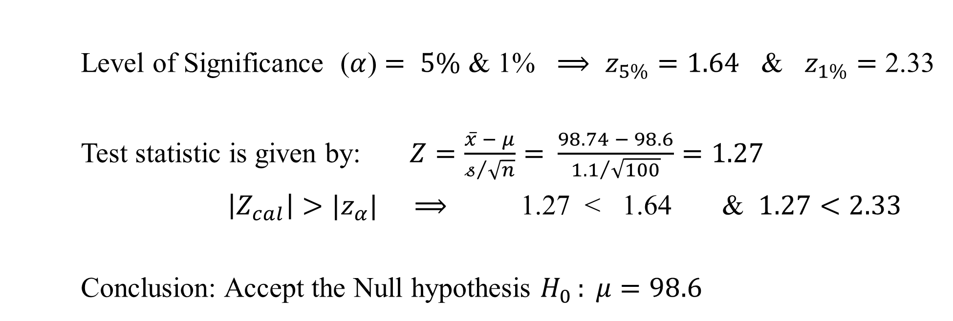
Level of Significance ($α$) $= 5\%$ & 1% $⟹$ $z_{5\%}=1.64$ & $z_{1\%}=$ 2.33
Test statistic is given by: $Z=\frac{\overline{x} − μ}{𝓈/{\sqrt{n}}}=$ $\frac{98.74 − 98.6}{{1.1}/{\sqrt{100}}}=1.27$
$\left|Z_{cal}\right|>{|z}_{α}|$ $⟹$ 1.27 < 1.64 & $1.27<2.33$
Conclusion: Accept the Null hypothesis $H_{0 }: μ=98.6$

Slide 34
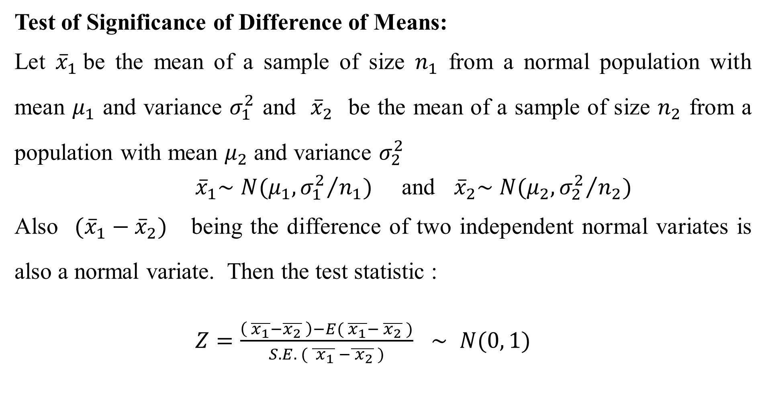
Test of Significance of Difference of Means:
Let ${\overline{x}}_{1}$be the mean of a sample of size $n_{1}$ from a normal population with mean $μ_{1}$ and variance $σ_{1}^{2}$ and ${\overline{x}}_{2}$ be the mean of a sample of size $n_{2}$ from a population with mean $μ_{2}$ and variance $σ_{2}^{2}$
${\overline{x}}_{1}\sim$ $N(μ_{1}, {σ_{1}^{2}}/{n_{1}})$ and ${\overline{x}}_{2}\sim$ $N(μ_{2}, {σ_{2}^{2}}/{n_{2}})$
Also $({\overline{x}}_{1}−{\overline{x}}_{2})$ being the difference of two independent normal variates is also a normal variate. Then the test statistic :
$Z=\frac{\left( \overline{x_{1}}−\overline{x_{2}} \right)−E( \overline{x_{1}}− \overline{x_{2}} )}{S.E. ( \overline{{ x}_{1}} −\overline{{ x}_{2}} )}$ $\sim$ $N(0, 1)$

Slide 35
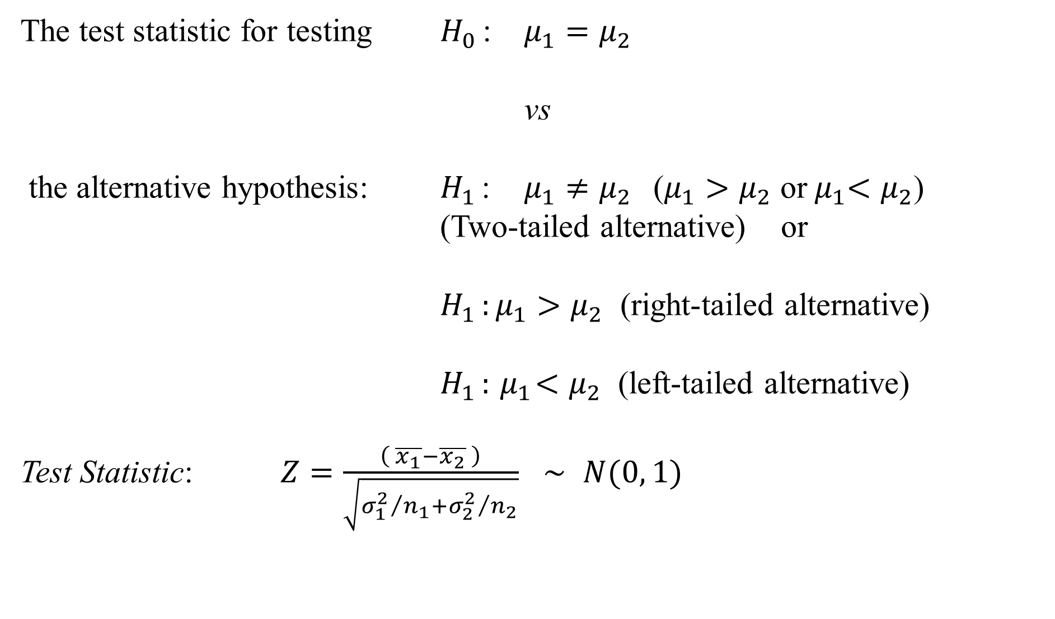
The test statistic for testing $H_{0 }$: $μ_{1}=μ_{2}$
vs
the alternative hypothesis: $H_{1 }$: $μ_{1}≠μ_{2}$($μ_{1}>μ_{2}$ or${ μ}_{1}<μ_{2}$)
(Two-tailed alternative) or
$H_{1 }:μ_{1}>μ_{2}$ (right-tailed alternative)
$H_{1 }:{ μ}_{1}<μ_{2}$ (left-tailed alternative)
Test Statistic: $Z=\frac{\left( \overline{x_{1}}−\overline{x_{2}} \right)}{\sqrt{{σ_{1}^{2}}/{n_{1}}+{σ_{2}^{2}}/{n_{2}}}}$ $\sim$ $N(0, 1)$

Slide 36
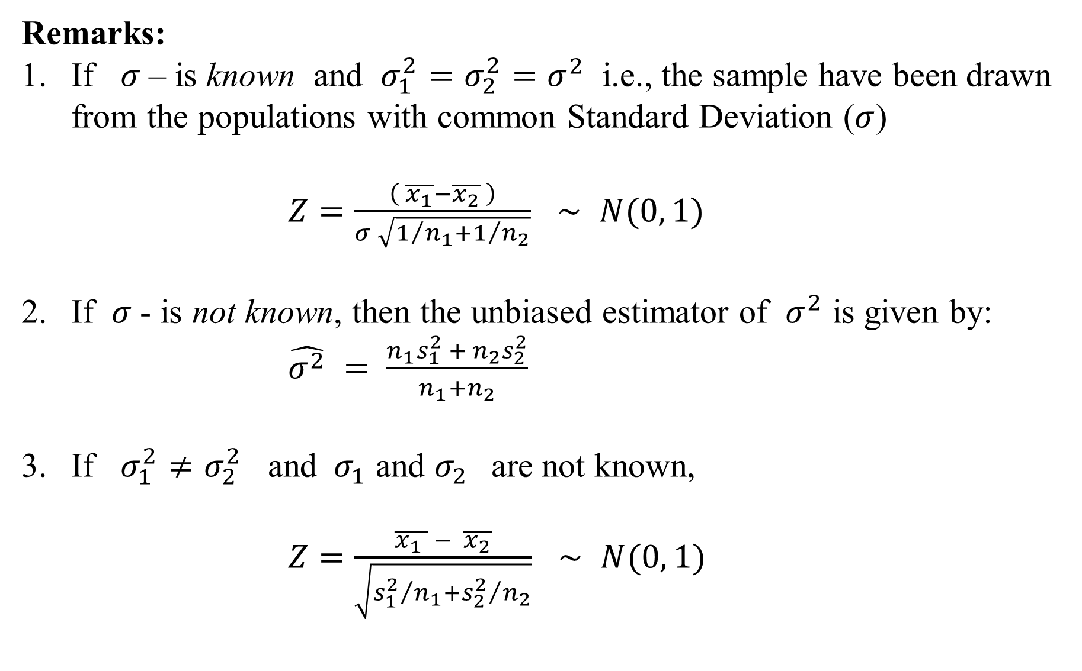
Remarks:
If $σ$– is known and $σ_{1}^{2}=σ_{2}^{2}=σ^{2}$ i.e., the sample have been drawn from the populations with common Standard Deviation ($σ$)
$Z=\frac{\left( \overline{x_{1}}−\overline{x_{2}} \right)}{σ \sqrt{1/{n_{1}}+1/{n_{2}}}}$ $\sim$ $N(0, 1)$
If $σ$- is not known, then the unbiased estimator of $σ^{2}$ is given by:
$\hat{σ^{2}} =$ $\frac{n_{1}s_{1}^{2} + n_{2}s_{2}^{2}}{n_{1}+n_{2}}$
If $σ_{1}^{2}≠σ_{2}^{2}$ and $σ_{1}$ and $σ_{2}$are not known,
$Z=\frac{\overline{x_{1} } − \overline{x_{2}}}{\sqrt{{s_{1}^{2}}/{n_{1}}+{s_{2}^{2}}/{n_{2}}}}$ $\sim$ $N(0, 1)$

Slide 37
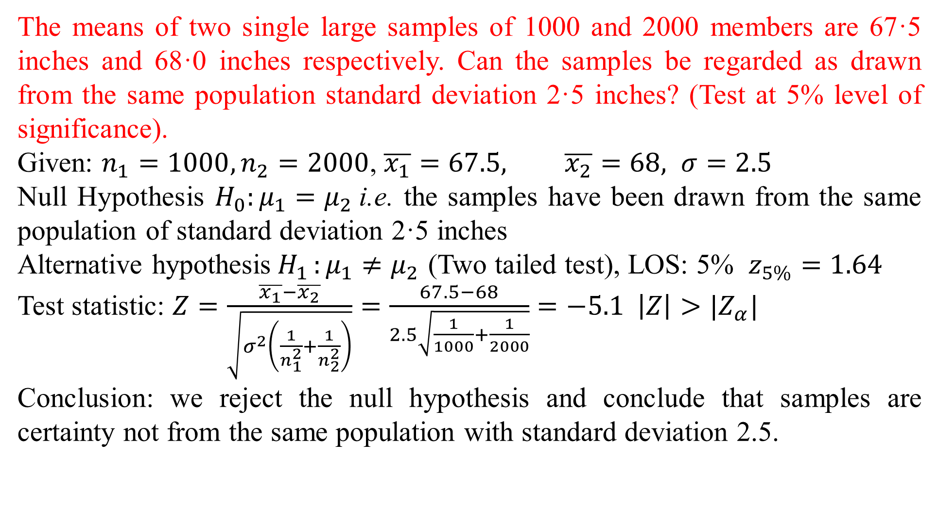
The means of two single large samples of 1000 and 2000 members are 67·5 inches and 68·0 inches respectively. Can the samples be regarded as drawn from the same population standard deviation 2·5 inches? (Test at 5% level of significance).
Given: $n_{1}=1000, n_{2}=2000$, $\overline{x_{1}}=67.5, \overline{x_{2}}=68, σ=2.5$
Null Hypothesis $H_{0}:μ_{1}=μ_{2}$i.e. the samples have been drawn from the same population of standard deviation 2·5 inches
Alternative hypothesis$H_{1 }:μ_{1}≠μ_{2}$ (Two tailed test), LOS: 5% $z_{5\%}=1.64$
Test statistic: $Z=\frac{\overline{x_{1}}−\overline{x_{2}}}{\sqrt{σ^{2}\left(\frac{1}{n_{1}^{2}}+\frac{1}{n_{2}^{2}}\right)}}=\frac{67.5−68}{2.5\sqrt{\frac{1}{1000}+\frac{1}{2000}}}=−5.1 \left|Z\right|>|Z_{α}|$
Conclusion: we reject the null hypothesis and conclude that samples are certainty not from the same population with standard deviation 2.5.

Slide 38
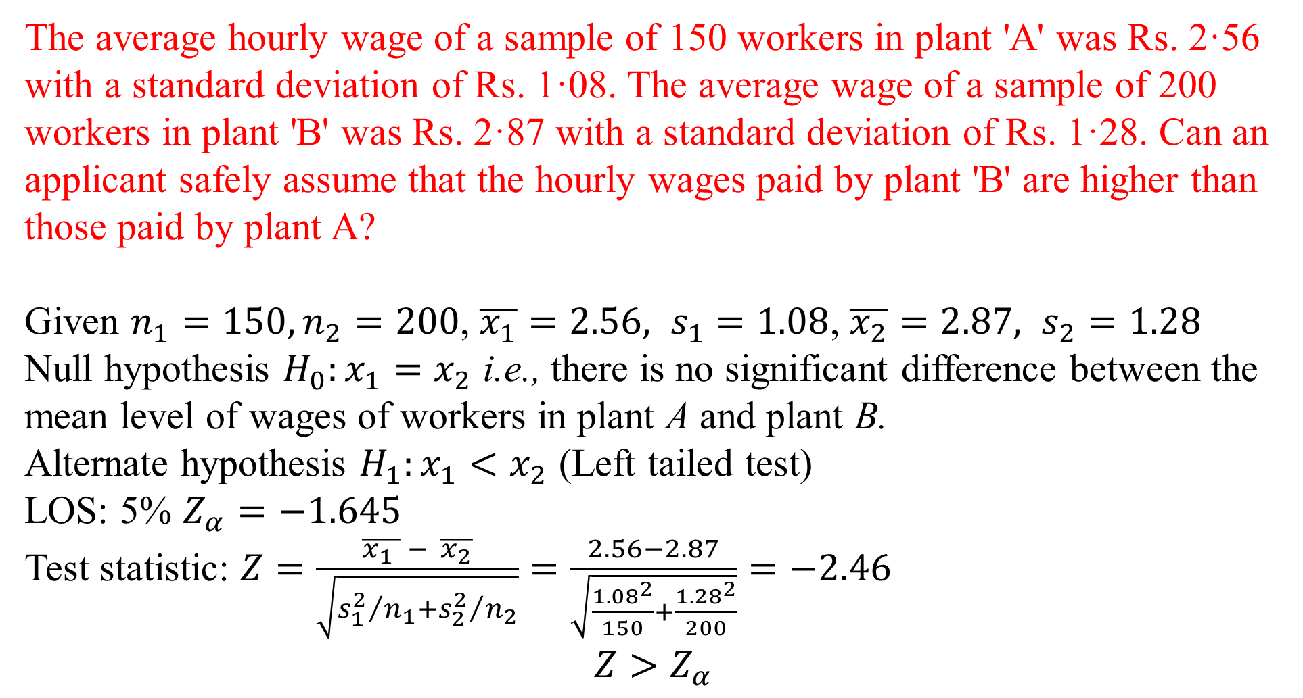
The average hourly wage of a sample of 150 workers in plant 'A' was Rs. 2·56 with a standard deviation of Rs. 1·08. The average wage of a sample of 200 workers in plant 'B' was Rs. 2·87 with a standard deviation of Rs. 1·28. Can an applicant safely assume that the hourly wages paid by plant 'B' are higher than those paid by plant A?
Given $n_{1}=150, n_{2}=200$, $\overline{x_{1}}=2.56, s_{1}=1.08$, $\overline{x_{2}}=2.87, s_{2}=1.28$
Null hypothesis $H_{0}:x_{1}=x_{2}$ i.e., there is no significant difference between the mean level of wages of workers in plant A and plant B.
Alternate hypothesis $H_{1}:x_{1}<x_{2}$ (Left tailed test)
LOS: 5% $Z_{α}=−1.645$
Test statistic: $Z=\frac{\overline{x_{1} } − \overline{x_{2}}}{\sqrt{{s_{1}^{2}}/{n_{1}}+{s_{2}^{2}}/{n_{2}}}}=\frac{2.56−2.87}{\sqrt{\frac{{1.08}^{2}}{150}+\frac{{1.28}^{2}}{200}}}=−2.46$
$$Z>Z_{α}$$

Slide 39
Conclusion:
Hence the null hypothesis is rejected at 5% level of significance and we conclude that the average hourly wages paid by plant 'B' are certainly higher than those paid by plant 'A'.

